Slide 1
Module: Cryptography
Lesson 2: Symmetric Key Algorithms

Slide 2
Cryptography Module
Module Description: ​
The intent of this Knowledge Unit is to provide students with an understanding of the concepts cryptography and its uses in in networking.
Topics:​
Lesson 1: Cryptography Overview
Lesson 2: Symmetric Key Algorithms, DES and AES
Lesson 3: Asymmetric Key Algorithms, RSA
Lesson 4: Cryptographic Protocols

Slide 3
Learning Outcomes
Upon completion of this lesson:
Students will be able to describe the basic concepts of symmetric key cryptography
Students will be able to explain the structure of DES and AES algorithms.
Students will be able to describe Double DES and Triple DES.
Students will be able to describe the encipherment modes ECB, CFB, PCFB, OFB, and CTR.

Slide 4
Symmetric Key Algorithms
Involve using one key for both encryption and decryption
Form the basis for two popular algorithms in use today
DES – Data Encryption Standard
AES – Advanced Encryption Standard
Look at general strategies of these algorithms then look at each of these in a little more detail

Slide 5
Block vs. Stream Cipher
Modern crypto systems usually consider message as a sequence of bits
(eg as a series of ASCII characters concatenated)
have two broad families of methods
stream ciphers and block ciphers
Block Cipher
In a block cipher, message is broken into blocks, each of which is then encrypted
(eg like a substitution on very big characters - 64-bits or more)
Most modern ciphers are of this form
Steam cipher
in a stream cipher, message is encrypted as it comes, usually one character at a time.

Slide 6
Block vs. Stream Cipher (part 2)
Process the message bit by bit (as a stream)
most famous of these is the Vernam cipher also called one-time pad
Invented by Vernam, working for AT&T, in 1917
Simply add bits of message to random key bits
Need as many key bits as message, difficult in practice
Is unconditionally secure provided key is truly random
Since difficult to distribute so much key
Why not generate keystream from a smaller (base) key
Use some pseudo-random function to do this
Example:RC4 stream cipher used in WEP for 802.11 wireless

Slide 7
Encipherment Modes
Many modern crypto systems treat a large message as if is were a stream of blocks. This stream of blocks can be enciphered with some built-in feedback. the Encipherment modes are:
Electronic Code Book (ECB)
each block is treated independently.
Cipher Block Chaining (CBC)
the plaintext is XORed with the previous cipher block (or an initialization vector for the first block). This adds to diffusion
Cn = E(Kn, Pn XOR Cn-1) where C0 is initialization vector
Pn = D(Kn,Cn) XOR Cn-1 for decryption

Slide 8
Encipherment Modes (part 2)
Propagating Cipher Block Chaining (CBC)
the plaintext is XORed with the previous cipher block (or an initialization vector for the first block) and XORed with the prior plaintext.
Cn = E(Kn, Pn XOR Cn-1 XOR Pn-1) where C0 is initialization vector and P0 is all zeros.
Pn = D(Kn,Cn) XOR Cn-1 XOR Pn-1 for decryption
Cipher Feedback Mode (CFB).
makes a block cipher into a self-synchronzing stream cipher. Let K0 be the encryption key, C0 be initialization vector.
Kn = E(K,Cn-1) -- generates a key the size of the block.
Cn = Kn XOR Pn -- now can use parts of Kn (say 8 bits at a time), for each character in Pn.

Slide 9
Encipherment Modes (part 3)
Output Cipher Feedback Mode (OFB).
makes a block cipher into a stream cipher. Let K0 be the encryption key, C0 be initialization vector.
Kn = E(K,Kn-1) -- generates a key the size of the block.
Cn = Kn XOR Pn -- now can use parts of Kn (say 8 bits at a time), for each character in Pn.
Note that we use Kn-1 not Cn-1 as input into the next block
Counter Mode (CTR)
makes a block cipher into a stream cipher, but allows random access by blocks. No diffusion.
Kn = E(K,Counter(n))
Cn = Kn XOR Pn
Can combine a none/initialization vector with the counter through XOR (or if nonce is non-random, can concatenate with counter upper half is nonce bits, lower half is counter bits)

Slide 10
Shannon’s Theory
Claude Shannon wrote some pivotal papers on modern cryptology theory in 1949
In these he developed concepts of:
Entropy of a message – variability
Redundancy in language,
For example, think about abbreviations or shortened words used in texting. We can still read them, because of context and redundancy in English.
Theories about how much information is needed to break cipher
Defined concepts of computationally secure vs. unconditionally secure ciphers

Slide 11
Shannon’s Theory
Substitution-Permutation Ciphers
In his 1949 paper Shannon introduced idea of substitution-permutation (S-P) networks, which now form basis of modern block ciphers
An S-P network is modern form of a substitution-transposition product cipher
S-P networks are based on two primitive cryptographic operations substitution and permutation.

Slide 12
Shannon’s Theory
Substitution Operation
Binary word is replaced by some other binary word
Whole substitution function forms key
If we use n bit words, the key is 2^{n}! bits -- grows rapidly
Can also think of this as large lookup table, with n address lines (hence 2^{n} addresses), each n bits wide being output value
Will call them S-boxes

Slide 13
Shannon’s Theory
Permutation Operation
Binary word has its bits reordered (permuted)
Re-ordering forms key
If use n bit words, key is n! bits, which grows more slowly, and hence is less secure than substitution
Equivalent to wire-crossing in practice
Will call these P-boxes

Slide 14
Shannon’s Theory
Substitution-Permutation Network
Shannon noted that two weak but complementary ciphers can be made more secure by applying them together
Shannon combined these two primitives in a structure called product cipher
S-Boxes
provide confusion of input bits
P-Boxes
provide diffusion across S-box inputs

Slide 15
Confusion and Diffusion
Introduced by Claude Shannon to thwart cryptanalysis based on statistical analysis
Assume attacker has some knowledge of statistical characteristics of plaintext
Cipher needs to completely obscure statistical properties of original message
One-time pad does this
diffusion – dissipates statistical structure of plaintext over bulk of ciphertext
confusion – makes relationship between ciphertext and key as complex as possible

Slide 16
Implementing S-P Networks
In practice need to be able to decrypt messages, as well as to encrypt them, hence either:
Have to define inverses for each of our S & P-boxes, but this doubles the code/hardware needed, or
Define structure that is easy to reverse, so can use basically same code or hardware for both encryption and decryption

Slide 17
Implementing S-P Networks
Horst Feistel, working at IBM Research Labs devised just such a structure in early 70's, which we now call a feistel cipher
Idea is to partition input block into two halves,
L(i-1)and R(i-1), and use only R(i-1)in each round i (part) of the cipher
Function g incorporates one stage of the S-P network, controlled by part of key K(i) known as the ith subkey

Slide 18
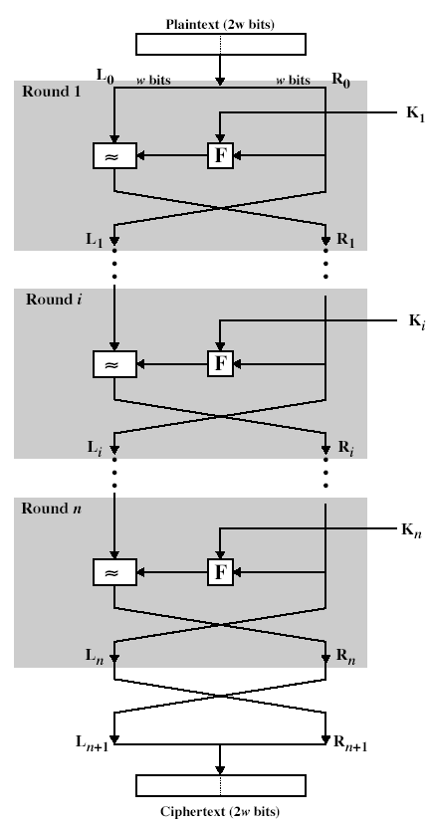
Feistel Cipher Structure Diagram

Slide 19
Feistel Cipher Structure
This can be described functionally as:
L(i) = R(i-1)
R(i) = L(i-1) (+) g(K(i), R(i-1))
In practice link a number of these stages together (typically 16 rounds) to form the full cipher
Feistel structure advantage is encryption and decryption operations are similar, even identical in some cases, requiring only reversal of key schedule.
Therefore size of code or circuitry required to implement such a cipher is nearly halved
Used in DES ...

Slide 20
DES Algorithm History
DES
In 1970’s US National Bureau of Standards (NBS) recognized that general public needed a secure encryption technology to protect sensitive information
Historically, US DOD has a continuing interest in encryption systems (NSA)
In 1972, NBS issued a call for proposals for producing a public encryption algorithm

Slide 21
DES Algorithm NBS Criteria
NBS specified following criteria for an encryption algorithm:
High level of security
Specified and easy to understand
Publishable, security does not depend on the secrecy of the algorithm
Available to all users
Efficient to use
Exportable

Slide 22
DES Algorithm Responses
Few Organizations responded to NBS call
Second announcement in 1974
IBM responded with Lucifer algorithm
Lucifer used simple logical operations on relatively small quantities
Algorithm could be implemented in either hardware or software on conventional computers
final algorithm was developed by IBM for NBS – became known as DES
Stands for Data Encryption Standard

Slide 23
DES Algorithm IBM Submission
NSA analyzed DES algorithm
Found no serious flaws
Became a standard in 1976
Authorized for use by all public and private sector unclassified communication
Eventually, DES was accepted as an international standard

Slide 24
DES Algorithm Overview
Overview of DES
The DES performs series of bit permutation, substitution, and recombination operations on blocks containing 64 bits of data and 56 bits of key
64 bits of input are permuted initially, and then input to a function using static tables of permutations P-boxes and substitutions S-boxes

Slide 25
DES Algorithm Cycles
Cycles
Break permuted data into two halves, 32 bits each
Key gets transformed
Key shifted left by some number and permuted
Key bits get dropped so only 48 bits used
Right half of data expanded to 48 bits – duplicates certain bits
Right half combined with 48 bits of key
Result is substituted for another result and condensed to 32 bits
32 bits are permuted and then combined with left half to yield a new right half

Slide 26
DES Algorithm Cycles (continued)
Cycles
Process iterated 16 times (rounds), each time with different set of tables and different bits from key
Algorithm then performs final permutation, and 64 bits of output are provided

Slide 27
DES Diagram
Right Half of Text 32
DES Algorithm
Left Half of Text 32
Expand and Permute 48
Key – shifted 56 bits
bits dropped
Combine
Key
Key – Permuted 48 bits
Repeat
16 times
Substitute
Permute
Add halves
New Left Half Text
New Right Half Text

Slide 28
DES Algorithm Decryption
Decryption
Decryption uses the same algorithm and same secret key
Reversible process
Same function uses but keys must be taken in reverse order (k16, k15, ....k1)

Slide 29
Strengthening DES Algorithm
Double DES
DES key is fixed at 56 bits
Not considered long by today’s standards
Wanted to increase key length of DES but can’t
DES algorithm is fixed at 56 bits
Researchers suggested doubling DES algorithm for greater security
Take two keys instead of 1 and perform two encryptions

Slide 30
Double DES Algorithm
Double DES
Should in theory multiply difficulty making it harder to break
Like two locks
Instead of 22 you would get 22n
However, two researchers, Diffie and Hellman showed that two encryptions are not better than one
Strength of cipher is usually exponential in size of key
So doubling key actually squares the complexity, but applying encryption twice at best doubles complexity
However, Triple DES does work!

Slide 31
Double DES Algorithm Attack
In Double DES, each 64-bit block of data is encrypted twice with the DES algorithm, first with one key, then with another, as follows:
Encrypt with (key 1).
Encrypt with (key 2).
The meet-in-the-middle attack works by encrypting from one end and decrypting from other end, thus meeting in the middle.

Slide 32
Double DES Meet in the Middle Attack
Assume the attacker knows a set of plaintext and ciphertext:
P and C. That is, C = E(K2, E(K1,P))
where K1 and K2 are two keys.
Attacker can then compute EK(P) for all possible keys K and store results in memory.
Afterwards he can compute DK(C) for each K and compare with table in memory.
If he gets match it is likely that he has discovered two keys and can verify it with second set of plaintext and ciphertext

Slide 33
Double DES Summary
Because message encrypted with DES can be forcibly decrypted by an attacker performing an exhaustive key search today, an attacker might also be able to forcibly decrypt a message encrypted with Double DES using a meet-in-the-middle attack at some point in the future.
“2⁵⁷ is still considerably more memory storage than one could comfortably comprehend, but it's enough to convince the most paranoid of cryptographers that double encryption is not worth anything,"
Bruce Schneier from Applied Cryptography.

Slide 34
DES Algorithm – Triple DES
Triple DES
Using two keys, you apply them in 3 operations which adds strength
You encrypt with one key, decrypt with the second key and encrypt with the first key again
Three applications of the DES algorithm but it only doubles the effective key length – 112 bit key which is still very strong against all feasible known attacks!

Slide 35
DES Algorithm – Differential Cryptanalysis
How strong is DES?
DES has been questioned by analysts
In 1990, Biham and Shamir invented technique called differential cryptanalysis, that investigates change in algorithm strength when a crypto algorithm changes
Looked at DES and showed that any change to the algorithm weakens it
Change iterations from 16 to 15, change expansion or substitution rules and weakened algorithm could be broken

Slide 36
DES Algorithm – Breaking DES
How Strong is DES?
Diffie and Hellman argued that DES key length wasn’t strong enough given that computers will be increasing in processing power
In 1997, researchers using over 3500 machines in parallel were able to infer DES key in 4 months
In 1998, researchers built DES cracker machine and found DES key in 4 days
Triple DES was still beyond power of these machines
But it was clear that stronger algorithm was needed

Slide 37
AES Algorithm – New Call for Standard
AES, the Beginning
In 1997, NIST (NBS became NIST) did another call for proposals
Wanted an algorithm with these qualities:
Unclassified
Publicly disclosed
Available royalty-free for use worldwide
Symmetric block cipher algorithms – for blocks of 128 bits
Usable with key lengths of 128, 192 and 256 bits

Slide 38
AES Algorithm – The finalists
AES, the Beginning
In 1999, five finalists were selected and underwent intense public and private scrutiny
Looked at security but also at cost or efficiency, ease of implementation in software
Winning algorithm submitted by two Dutch cryptographers – Vincent Rijmen and Joan Daemon
Became known as the Rijndahl algorithm
Called AES and was adopted in 2001
Became Federal Information Processing Standard 197 (FIPS 197)

Slide 39
AES Algorithm - Rijndael
Overview of Rijndael
Fast algorithm
Can be implemented on simple processor
Uses substitution and transposition plus shift, XOR and addition operations
Uses repeat cycles – called rounds in Rijndael
Each cycle consists of 4 steps

Slide 40
AES Algorithm - Overview
Overview AES
Each cycle has four steps
1. Byte substitution
Uses byte substitution box structure similar to DES
Substituting each byte of a 128 bit block according to a substitution table
2. Shift Row
Transposition step
For 128 and 192 bit block sizes, row n is shifted left circular (n-1) bytes
For 256 bit blocks, row 2 is shifted 1 byte and rows 3 and 4 are shifted 3 and 4 bytes respectively

Slide 41
AES Algorithm – Overview (part 2)
3. Mix Columns
Shifting left and Xoring the bits with themselves
4. Add subkey
Portion of key unique to this cycle is Xor’ed with cycle result
Steps perform both confusion and diffusion on input data
Bits from key are combined with intermediate results frequently so key bits will be well diffused

Slide 42
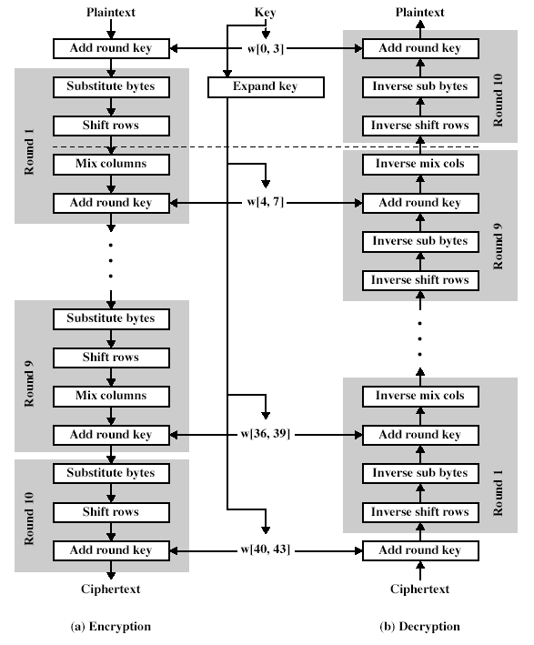
Rijndael Diagram

Slide 43
AES Algorithm – Compared to DES
Compare DES and AES
When evaluating DES, asked two questions ..
1) How strong is DES, any backdoors?
2) How long until encrypted code could be routinely cracked
In 20 years research has not found any major flaws in DES
Changes appear to weaken algorithm
DES does have a fixed key size

Slide 44
AES Algorithm – Compared to DES (part 2)
Compare DES and AES
Same questions for AES ...
AES algorithm defined with 128, 192 and 256 key lengths
Start with key size more than double that of DES
AES more flexible
Can extend the cycle number
Can change other aspects of algorithm without weakening it

Slide 45
References
DES General
http://www.unix.org.ua/orelly/networking/puis/ch06_04.htm
Double Strength Research DES
R. C. Merkle and M. Hellman, "On the Security of Multiple Encryption," Communications of the ACM, Volume 24, Number 7, July 1981, pp. 465-467.
DES Strength
Hellman, M. 1979. "DES will be totally Insecure in 10 years", IEEE Spectrum, V16, 7, Jul. 1979, pp. 32-39

Slide 46
Please attribute Dr. Jim Alves-Foss and Dr. Jia Song, University of Idaho
Except where otherwise noted, this work is licensed under https://creativecommons.org/licenses/by-nc-sa/4.0/ Not withstanding the non-commercial license terms, non-profit educational institutions are granted a non-exclusive license to adapt and use this material, with attribution. Creative Commons and the double C in a circle are registered trademarks of Creative commons in the United States and other countries. Third party marks and brands are the property of their respective holders.
Project sponsored by the National Security Agency under grant Number H98230-17-1-0199. The United States Government is authorized to reproduce and distribute reprints notwithstanding any copyright notation herein.

